Slide 1
Building Android apps – Week 9a
2843-201710_MCS4993_M:Topics in MA/CS
2843-201710_MCS5993_M:Topics in Computer Science

Slide 2
Agenda
Under the hood
Android Architecture
Unzip the apk
command line
gradle
adb
emulators
SDK tools

Slide 4
Notes:
The Linux Kernel
Positioned at the bottom of the Android software stack, the Linux Kernel provides a level of abstraction between the device hardware and the upper layers of the Android software stack. Based on Linux version 2.6, the kernel provides preemptive multitasking, low-level core system services such as memory, process and power management in addition to providing a network stack and device drivers for hardware such as the device display, Wi-Fi and audio.
The original Linux kernel was developed in 1991 by Linus Torvalds and was combined with a set of tools, utilities and compilers developed by Richard Stallman at the Free Software Foundation to create a full operating system referred to as GNU/Linux. Various Linux distributions have been derived from these basic underpinnings such as Ubuntu and Red Hat Enterprise Linux.

Slide 5
Notes:
Android Runtime - Dalvik Virtual Machine
The Linux kernel provides a multitasking execution environment allowing multiple processes to execute concurrently. It would be easy to assume, therefore, that each Android application simply runs as a process directly on the Linux kernel. In fact, each application running on an Android device does so within its own instance of the Dalvik virtual machine (VM).
Running applications in virtual machines provides a number of advantages. Firstly, applications are essentially sandboxed, in that they cannot detrimentally interfere (intentionally or otherwise) with the operating system or other applications, nor can they directly access the device hardware. Secondly, this enforced level of abstraction makes applications platform neutral in that they are never tied to any specific hardware.
The Dalvik virtual machine was developed by Google and relies on the underlying Linux kernel for low-level functionality. It is more efficient than the standard Java VM in terms of memory usage, and specifically designed to allow multiple instances to run efficiently within the resource constraints of a mobile device.
In order to execute within a Dalvik VM, application code must be transformed from standard Java class files to the Dalvik executable (.dex) format, which has a 50% smaller memory footprint than standard Java bytecode. Standard Java class files can usually (though not always) be converted to Dex format using the dx tool included with the Android SDK.

Slide 6
Notes:
C/C++ libraries and Java interoperability libraries as well as lots of android libraries
A summary of some key core Android libraries available to the Android developer is as follows:
android.app – Provides access to the application model and is the cornerstone of all Android applications.
android.content – Facilitates content access, publishing and messaging between applications and application components.
android.database – Used to access data published by content providers and includes SQLite database management classes.
android.graphics – A low-level 2D graphics drawing API including colors, points, filters, rectangles and canvases.
android.hardware – Presents an API providing access to hardware such as the accelerometer and light sensor.
android.opengl – A Java interface to the OpenGL ES 3D graphics rendering API.
android.os – Provides applications with access to standard operating system services including messages, system services and inter-process communication.
android.media – Provides classes to enable playback of audio and video.
android.net – A set of APIs providing access to the network stack. Includes android.net.wifi, which provides access to the device’s wireless stack.
android.provider – A set of convenience classes that provide access to standard Android content provider databases such as those maintained by the calendar and contact applications.
android.text – Used to render and manipulate text on a device display.
android.util – A set of utility classes for performing tasks such as string and number conversion, XML handling and date and time manipulation.
android.view – The fundamental building blocks of application user interfaces.
android.widget - A rich collection of pre-built user interface components such as buttons, labels, list views, layout managers, radio buttons etc.
android.webkit – A set of classes intended to allow web-browsing capabilities to be built into applications

Slide 7
Notes:
Application Framework
The Application Framework is a set of services that collectively form the environment in which Android applications run and are managed. This framework implements the concept that Android applications are constructed from reusable, interchangeable and replaceable components. This concept is taken a step further in that an application is also able to publish its capabilities along with any corresponding data so that they can be found and reused by other applications.
The Android framework includes the following key services:
Activity Manager – Controls all aspects of the application lifecycle and activity stack.
Content Providers – Allows applications to publish and share data with other applications.
Resource Manager – Provides access to non-code embedded resources such as strings, color settings and user interface layouts.
Notifications Manager – Allows applications to display alerts and notifications to the user.
View System – An extensible set of views used to create application user interfaces.
Package Manager – The system by which applications are able to find out information about other applications currently installed on the device.
Telephony Manager – Provides information to the application about the telephony services available on the device such as status and subscriber information.
Location Manager – Provides access to the location services allowing an application to receive updates about location changes.

Slide 8
Notes:
Applications
Located at the top of the Android software stack are the applications. These comprise both the native applications provided with the particular Android implementation (for example web browser and email applications) and the third party applications installed by the user after purchasing the device.

Slide 9
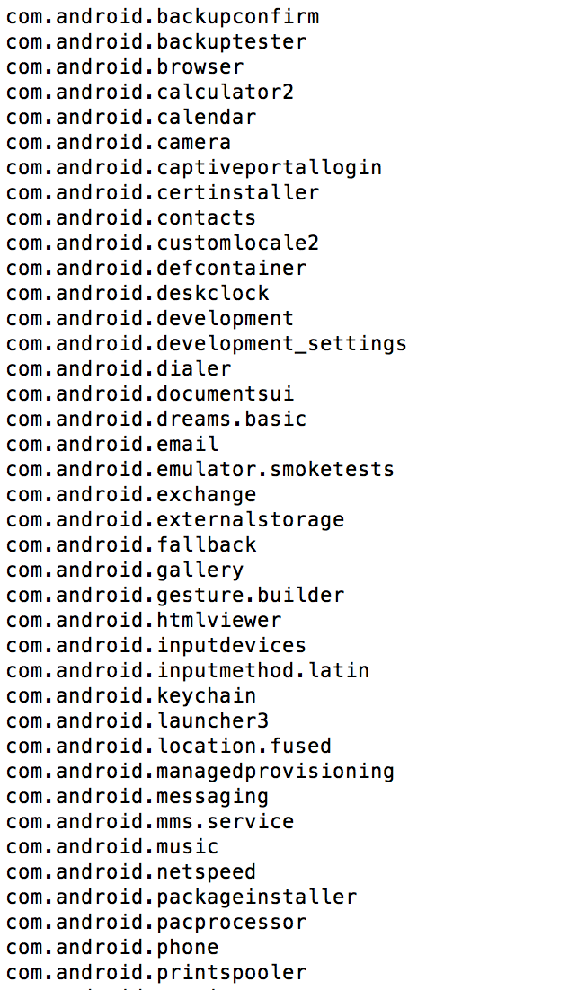
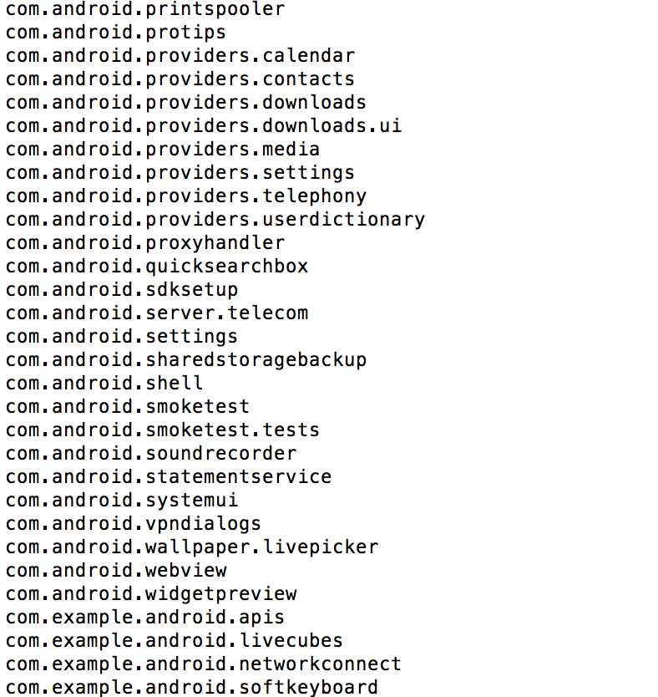
Notes:
If you adb shell and do ls –l on the /data/data folder you can see a lot of the data

Slide 10
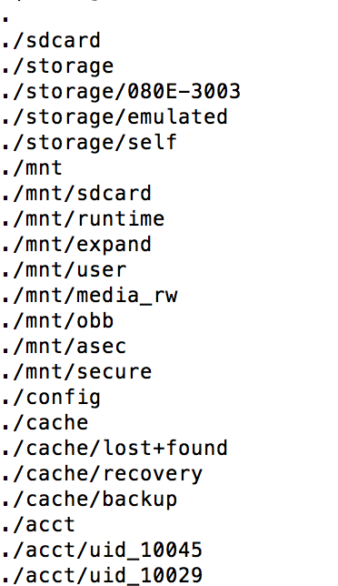
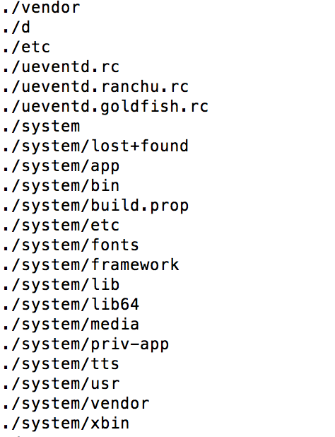
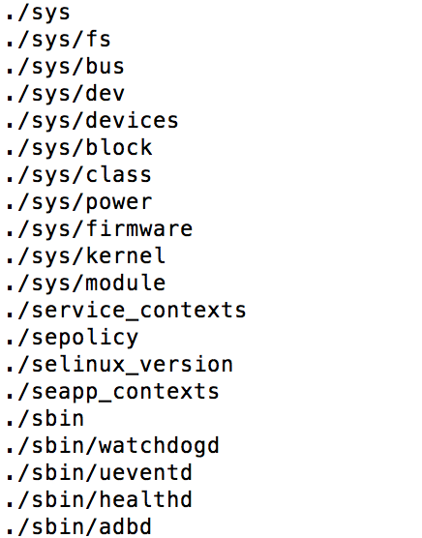
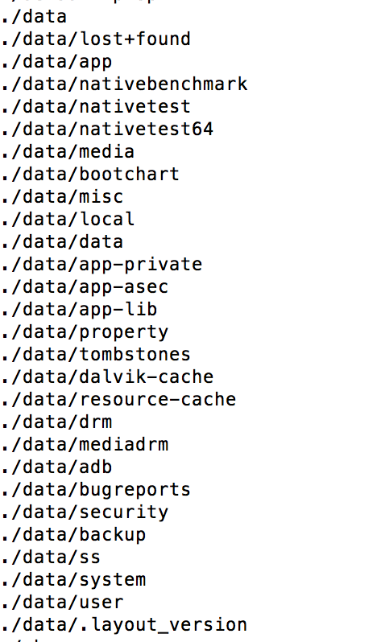
Notes:
Do a find . on the root directory of the emulator

Slide 11
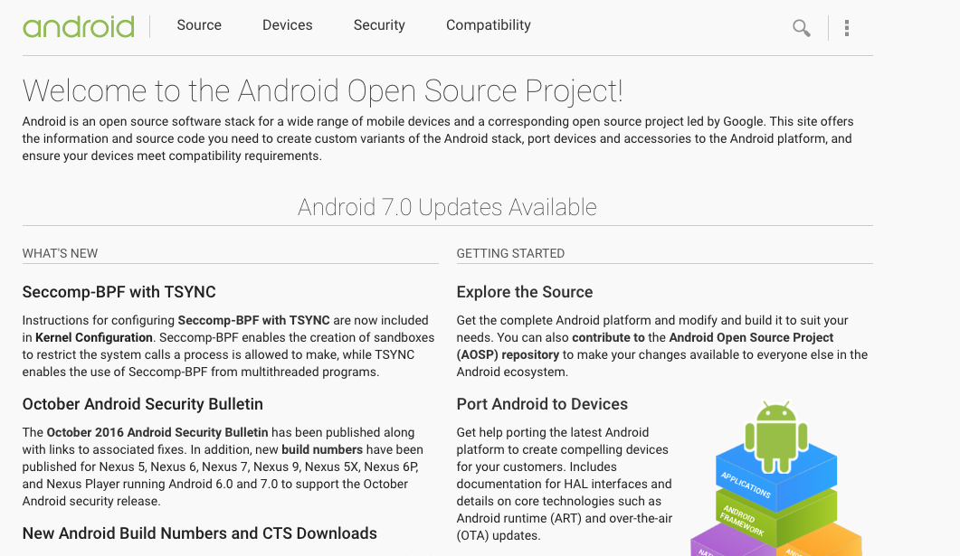
Notes:
http://source.android.com

Slide 12
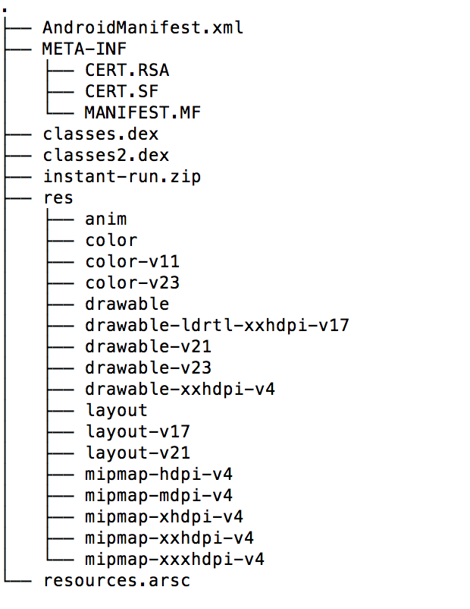
Notes:
Unzipped apk – mostly unreadable
But how do we get from out Java code to this format??

Slide 13
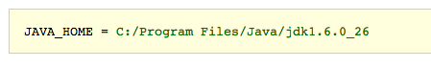
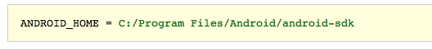
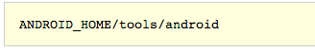
Notes:
Download Java http://www.oracle.com/technetwork/java/javase/downloads
Download Android http://developer.android.com/sdk.
The download includes the core parts of Android. In addition you need SDK(s) for the specific Android platforms you will develop for and test on. Launch the SDK manager GUI, select Available packages and open the Android Repository:
Select the required platform/tool packages (all is fine) and hit the Install Selected button. After installation, the platform/ and platform-tools/ directories of ANDROID_HOME should have been populated.
From http://geosoft.no/development/android.html

Slide 14
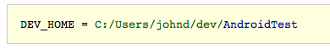
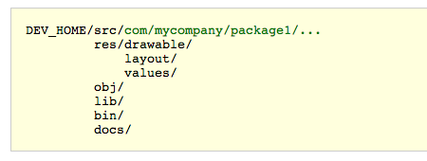
Notes:
Choose project name
At some disk location create a project directory that will hold the code, libraries and other files that constitutes the Android project. Create a pointer to this location:
4. Create development area
Beneath the project directory create sub directories as follows:
The src/ directory will hold java code and other source files in a package structure common for java projects. Using the reverse domain name system (Reverse DNS) for package names is optional but recommended. The res/ directory will hold user provided resources like text strings, images, menues, layouts etc. The res/ sub directories have predefined names according to the Android resource documentation. The obj/ directory will contain .class files and other secondary files produced by the Java tools as explained below. The lib/ directory should hold 3rd-party .jar files the project depends on. The bin/ directory will hold intermediate and final executables produced by the Android tools. The docs/ directory will hold javadoc HTML documents for the project. If generated, the docs/index.html file will be the entry point.

Slide 15
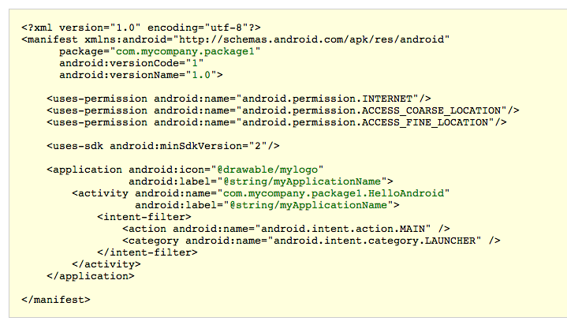
Notes:
5. Create manifest
The Android manifest file is used to specify application settings like name and version, as well as what permissions the application requires to run and what components it is comprised of. The file contains a singleapplication tag inside the root manifest tag.
Put the manifest file in the project root directory: DEV_HOME/AndroidManifest.xml. Note that the file must be called AndroidManifest.xml and nothing else.

Slide 16
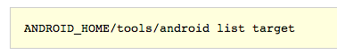
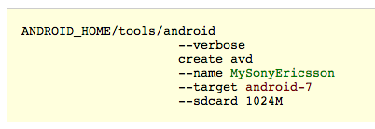
Notes:
6. Select target platform
The different Android OS versions are known through target names like android-3, android-4, android-5 etc. All available platforms can be listed by the following command: (API)
7. Define virtual device
An Android Virtual Device (AVD) defines the main characteristics of the target Android device. AVDs are used only when testing an Android program in the Android emulator. The typical approach is to define several AVDs in order to verify that a program behave correct across hardware platforms and OS versions.

Slide 17
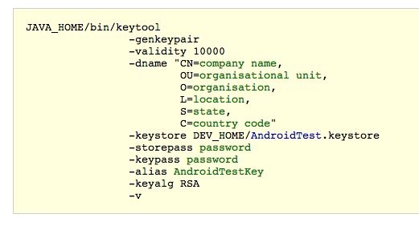
Notes:
8. Create keystore
A keystore is a database of private keys and their associated X.509 certificate chains authenticating the corresponding public keys. An Android program must be signed in order to execute on a device, and the program is signed by using a key from a keystore.
Use the keytool program to create a keystore:
Make sure to specify passwords as indicated. The key is accessed through the specified alias which can be any string.
The output of the command will be the DEV_HOME/AndroidTest.keystore file which contains one key identified by the supplied alias.

Slide 18
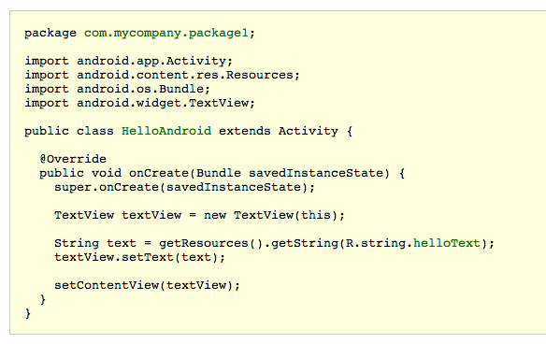
Notes:
9. Write code
Define a suitable package structure and put the Java code within the src/ tree of the project area.
The following minimal class can serve as an example. It should be located in DEV_HOME/src/com/mycompany/package1/HelloAndroid.java:

Slide 19
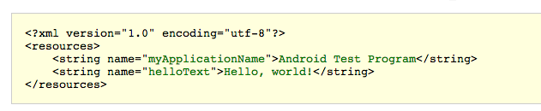
Notes:
10. Provide resources
Android programmers are advised to keep all non-logic data (text strings, images, animations, colors, layouts etc.) within the designated res/ directory of the project area. The res/ directory consists of a predefined set of sub directories with a naming structure that will simplify application localization and adoption to different hardware types.
The following minimal text resource can serve as an example. It should be located in DEV_HOME/res/values/strings.xml:

Slide 20
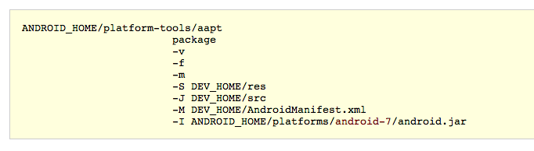
Notes:
11. Create R.java
In order for the application source code to be able to access the resources within the res/ directory, a class called R.java (for Resources) is created.
Use the Android Asset Packaging Tool (aapt) to create the R.java file:

Slide 21
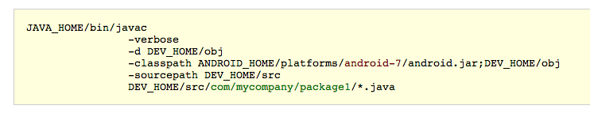
Notes:
12. Compile code
Use the javac tool to compile java source code in a package:
The command must be applied for each existing package. 3rd-party .jar files from the lib/ directory must be listed in the -classpath entry. Note that on UNIX-like operating systems the classpath entry delimiter should be a colon (":").
The output of the command is .class files in the obj/ tree.
Non-java files within the src/ tree must be copied to the associated location in the obj/ tree.

Slide 22
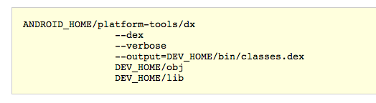
Notes:
13. Create DEX file
DEX ("Dalvik Executable") is the specific bytecode format understood by the Dalvik virtual machine (VM) present in all Android devices.
Use the dx tool to bundle the content of the obj/ directory as well as 3rd-party .jar files from the lib/ directory into a single .dex file:

Slide 23
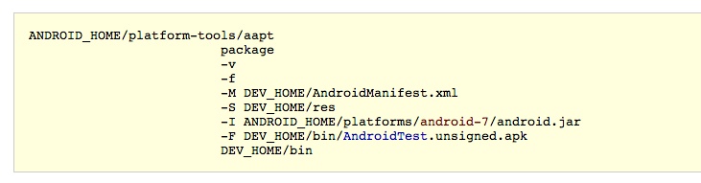
Notes:
14. Create APK file
The Android package format (APK) is the .jar equivalent for Android. The package contains the manifest file, the resources and the classes.dex file.
Use the aapt tool to create the .apk file:
This will create the AndroidTest.unsigned.apk file in the bin/ directory. Note that APK is an ordinary archive format that can be inspected by tools like WinZip or unzip -l.

Slide 24
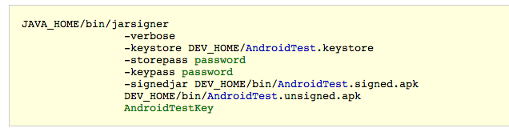
Notes:
15. Sign APK file
In order to execute on an Android device, the Android package needs to be signed.
Use the jarsigner tool and the key from the keystore created above to create a signed version of the package:
The signing process adds the META-INF/ directory to the APK archive including the signature (.SF) file and the associated PKSC file (.RSA).
The signed APK is stored as AndroidTest.signed.apk file in the bin/ directory.

Slide 25
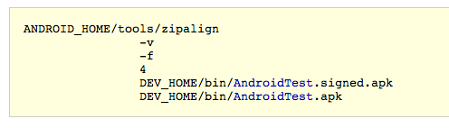
Notes:
16. Zip-align APK file
zipalign is an archive alignment tool that provides important optimization to Android packages. This step is optional, but recommended:

Slide 26
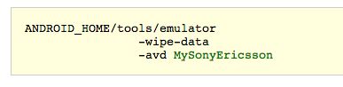
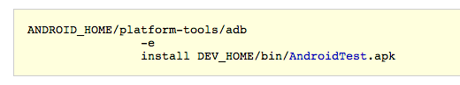
Notes:
17. Start emulator
In order to test the application, start the Android emulator and specify the virtual device (AVD) to use:
18. Install in emulator
When the emulator is ready, use the Android Debug Bridge (adb) tool to install the Android package in the running emulator:

Slide 27
What does Android Studio do?
gradlew build – Hello Unit Test
Uses Gradle
DSL – Domain Specific Language for Groovy
Definition in build.gradle (app) file
Notes:
Android Studio doesn’t do this, because it’s way more complicated now, uses build.gradle instead

Slide 28
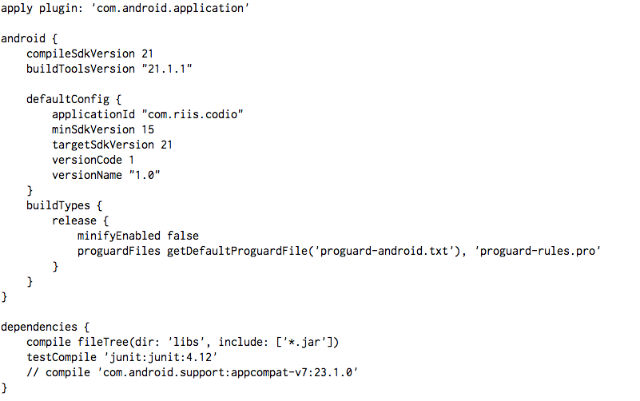
Notes:
SHOW CODIO
Run gradlew build, gradlew tests, gradlew tests

Slide 29
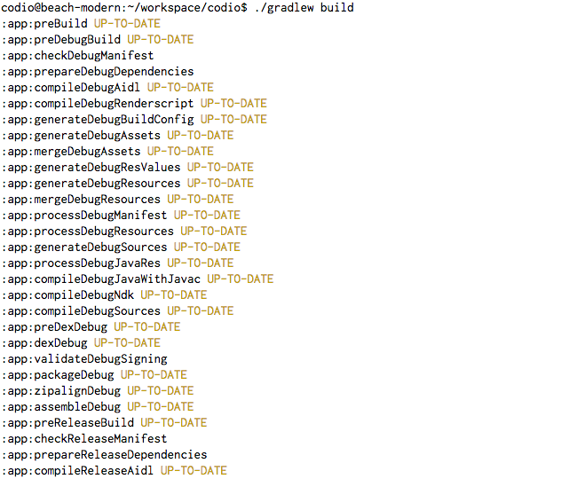
Notes:
SHOW CODIO
Run gradlew build, gradlew tests, gradlew tests
Normally this shows up in the gradlew console in android studio

Slide 30
ADB – Android Debug Bridge
Notes:
Every time your development machine needs to talk to an Android device, whether it’s a real device connected with a USB cable, or a virtual device running in an emulator, it does it by using the Android Debug Bridge (adb). The adb is a process that’s controlled by a command that’s also called adb.
The adb command is stored in the platform-tools directory of the Android System Developer’s Kit. On a Mac, you’ll probably find it in/Users/<username>/Library/Android/sdk/platform-tools. If you add the platform-tools directory to your PATH, you will be able to run adb from the command line.
The adb devices command means “Tell me which Android devices you are connected to”. The adb command works by talking to an adb server process, which runs in the background. The adb server is sometimes called the adb dæmon or adbd. When you enter an adb command in a terminal, a request is sent to network port 5037 on your machine. The adbd listens for commands to come in on this port. When Android Studio wants to run an app, or check the log output, or do anything else that involves talking to an Android device, it will do it via command port 5037.

Slide 31
Notes:
When the adbd receives a command, it will forward it to a separate adbd process that’s running in the relevant Android device. This will then be able to make changes to the Android device or return the requested information.

Slide 32
Notes:
Sometimes, if the adb server isn’t running, the adb command will need to start it:

Slide 33
Notes:
Likewise, if ever you plug in an Android device and Android Studio can’t see it, you can manually kill the adb server and restart it:

Slide 34
Notes:
Most of the time you won’t use adb directly; you’ll let an IDE like Android Studio do the work for you. But there are times when it can be useful to go to the command line and interact with your devices directly.
The adb shell command will open up an interactive shell directly on the Android device. The adb shell command will only work when there is a single Android device connected, otherwise it won’t know which Android device you want to talk to.

Slide 35
Notes:
Once you open a shell to your device, you can run a lot of the standard Linux commands:

Slide 36
Notes:
Get the output from logcat
All of the apps running on your Android device sending their output to a central stream called the logcat. You can see the live output from the logcat by running theadb logcat command:
The logcat output will keep streaming until you stop it. It can be useful to run adb logcat if you want to store the output in a file. The adb logcat command is used by Android Studio to produce the output you see in the Devices/logcat frame.

Slide 37
Notes:
COPYING FILES TO/FROM YOUR DEVICE
The adb pull and adb push commands can be used to transfer files back and forth. For example, here we are copying the /default.prop/ properties file into a local file called 1.txt:

Slide 38
Notes:
And much, much more...
There are many, many commands that you can run using adb: you can back up and restore databases (very useful if you need to debug a problem with a database app), start the adb server on a different port, reboot machines, or just find out a lot of information about the running devices. To find out all the options available, just type adb on the command line:

Slide 39
Other commands
adb push
adb pull
adb emu
adb install / uninstall
adb backup / restore
adb bugreport
Notes:
Emu = emulator

Slide 40
Emulators
Notes:
An Android Emulator uses an open source application called QEMU (or Quick Emulator) to emulate the entire Android hardware device. It runs code that interprets machine code that’s intended to be run by the device’s processor. It has code that emulates the storage system, the screen, and pretty much every other piece of physical equipment on an Android device.

Slide 41
Speeding up the Emulator
Use a Real Device
Use an Emulator Snapshot
Use Hardware Acceleration HAXM
Use Genymotion ($$)

Slide 42
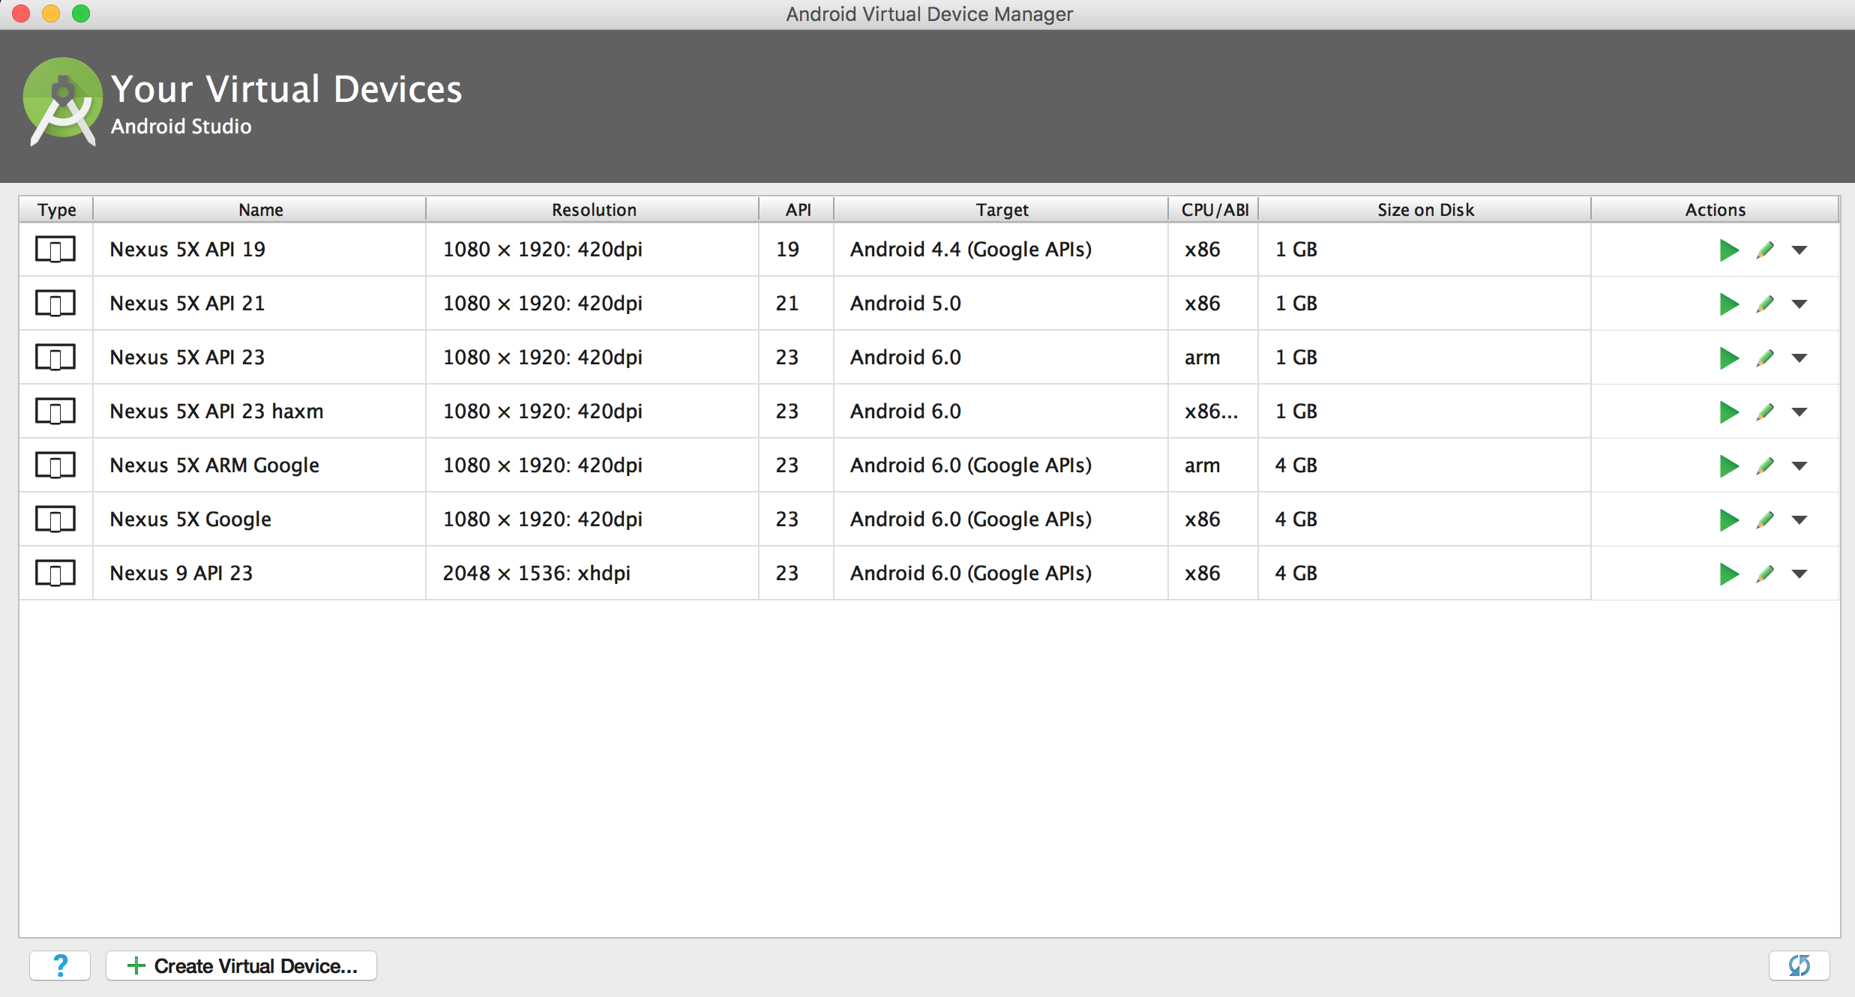
Notes:
Tools->Android->AVD Manager

Slide 43
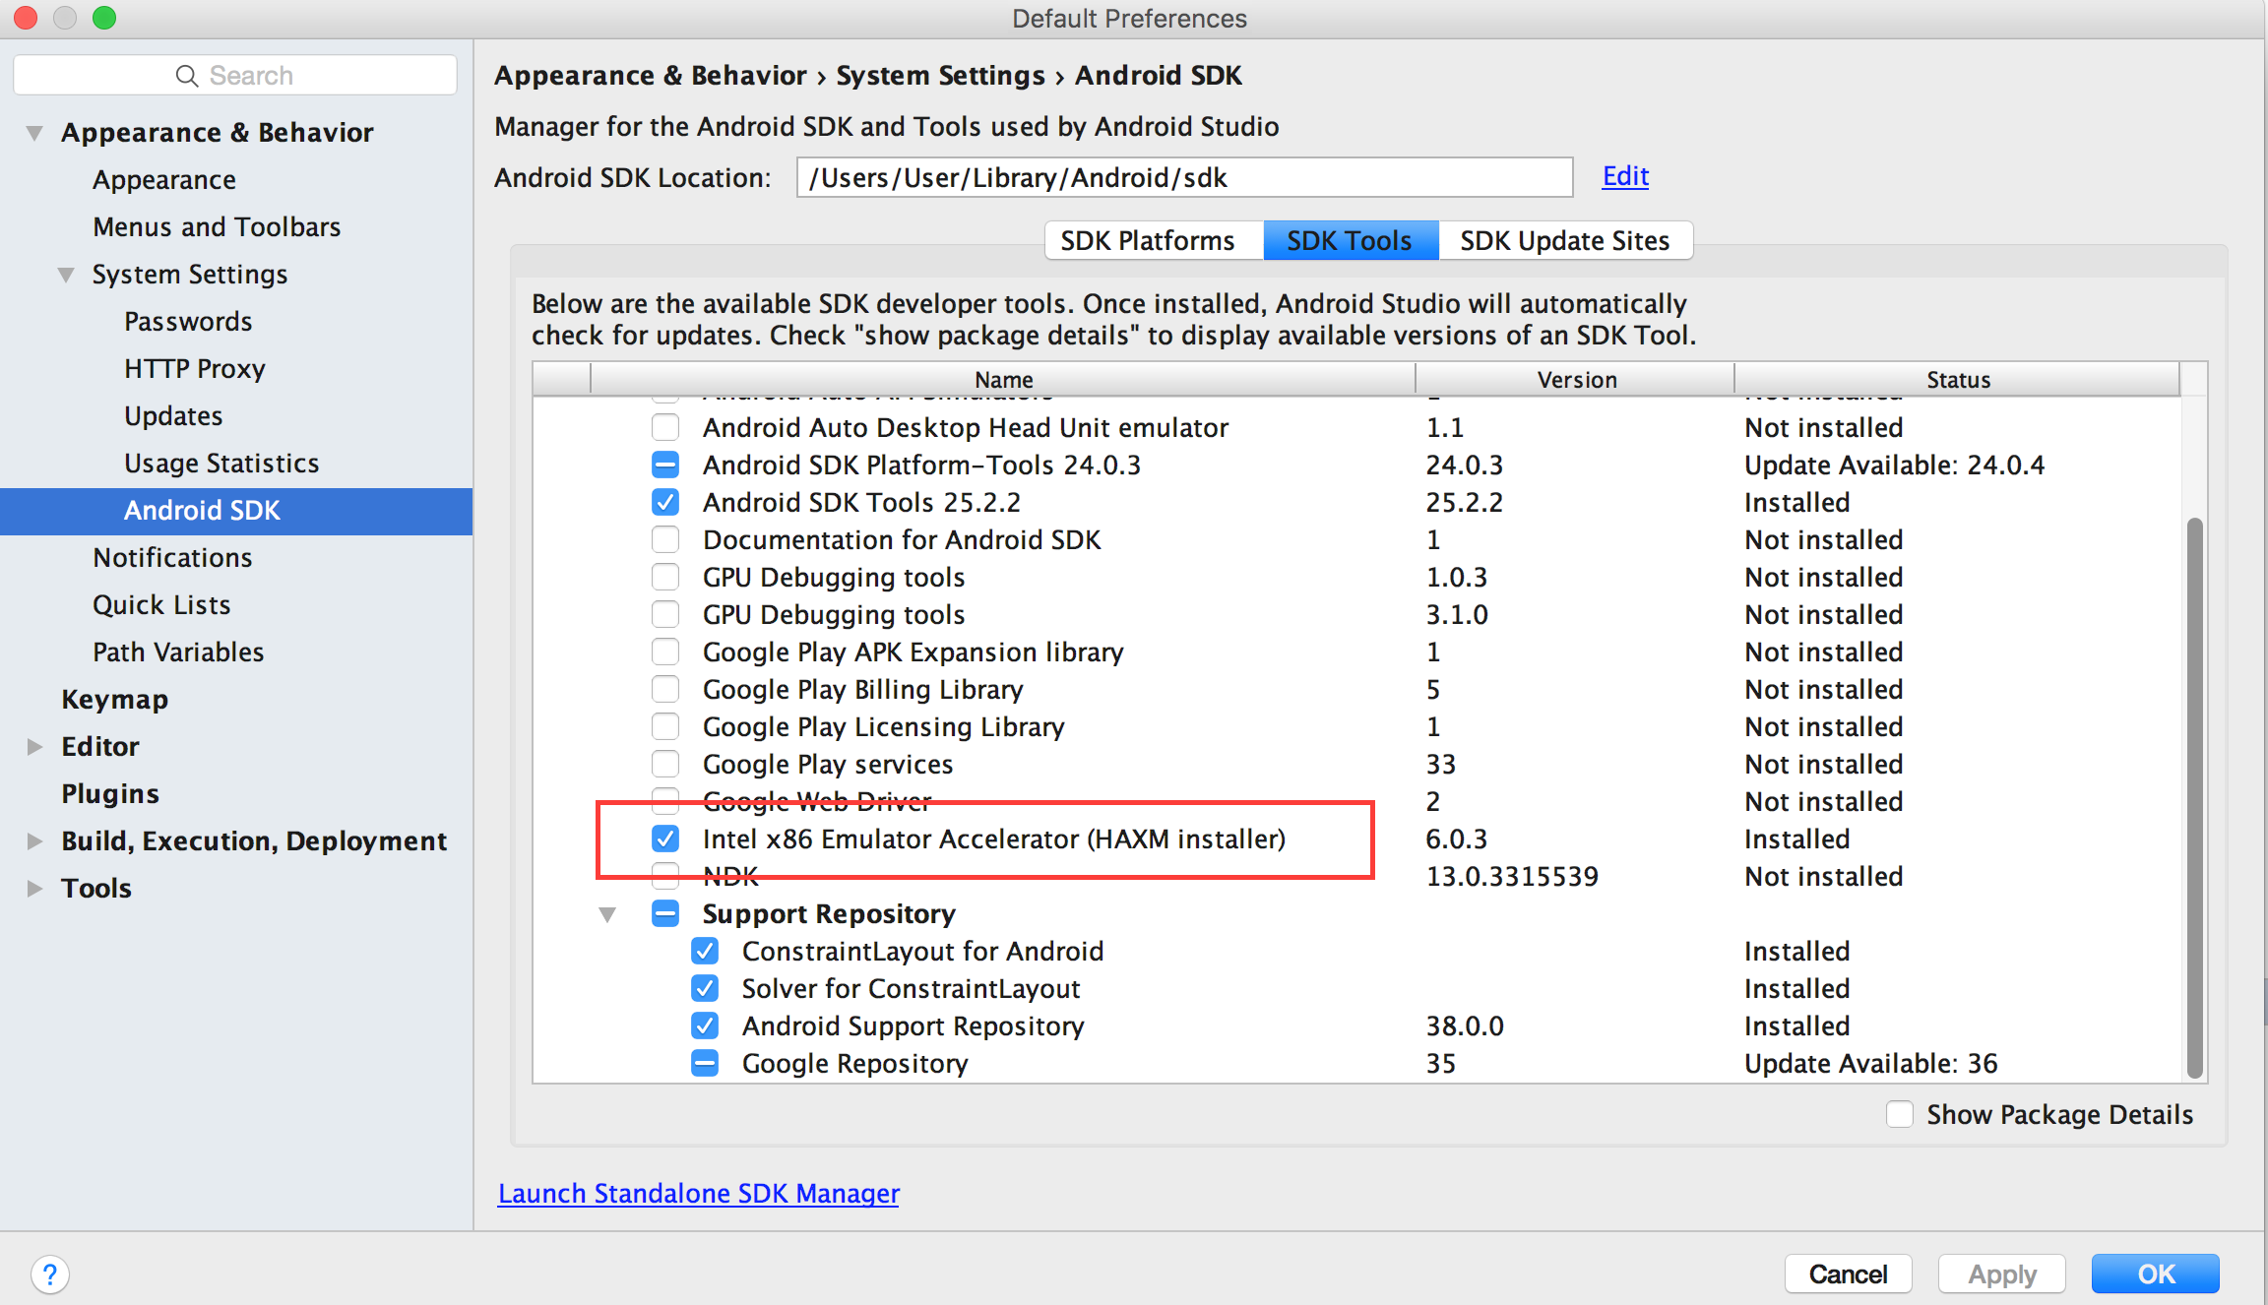
Notes:
Go to Tools -> Android -> SDK Manager
Click on SDK Tools

Slide 44
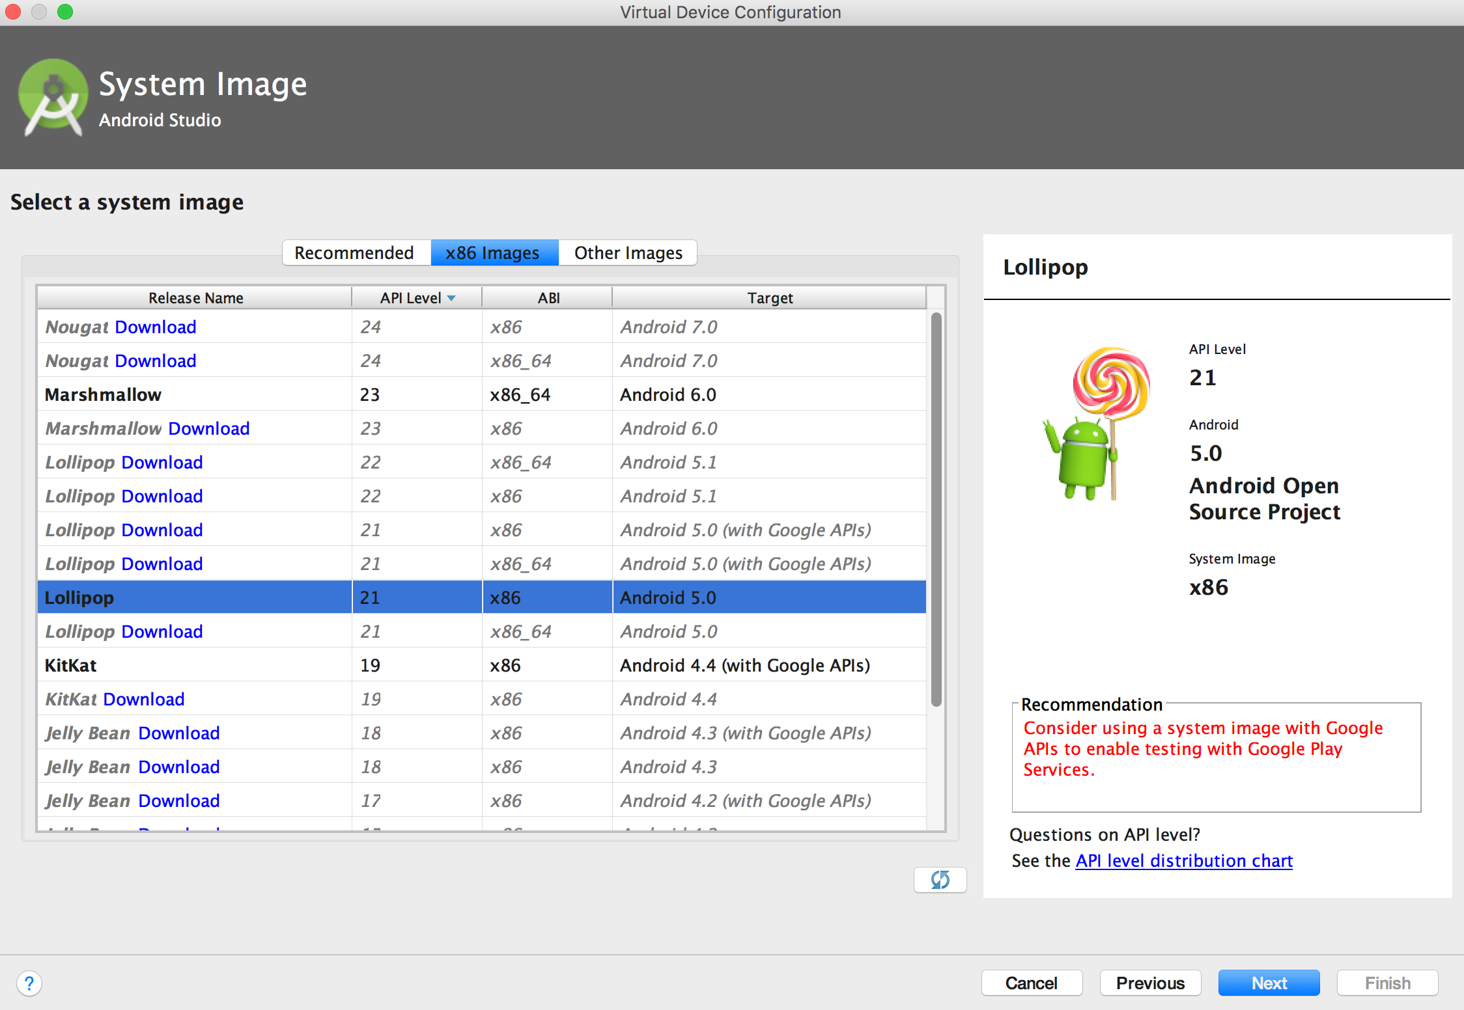
Notes:
Go to Tools->Android->AVD Manager->Create Virtual Device->Click on x86 Image.
Download if they’re not already downloaded
Need Intel processor with support for Intel® VT-x or Virtualization Technology

Slide 45
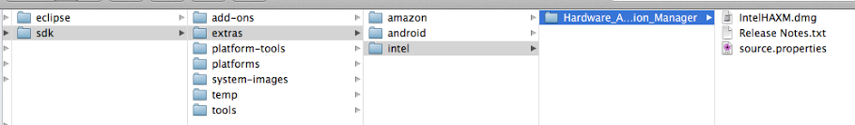
Notes:
Kvm on Linux

Slide 46
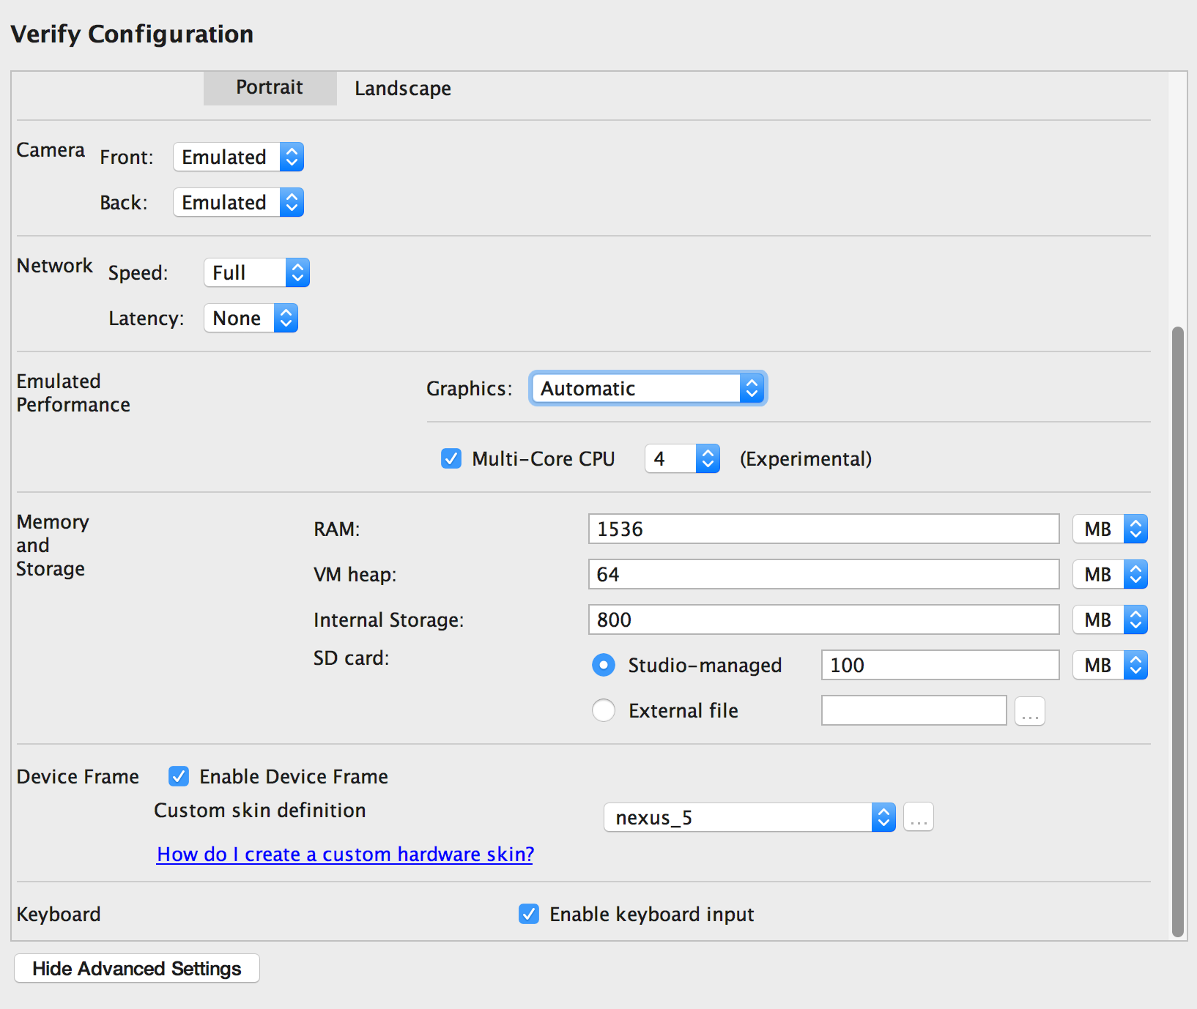
Notes:
Show

Slide 47
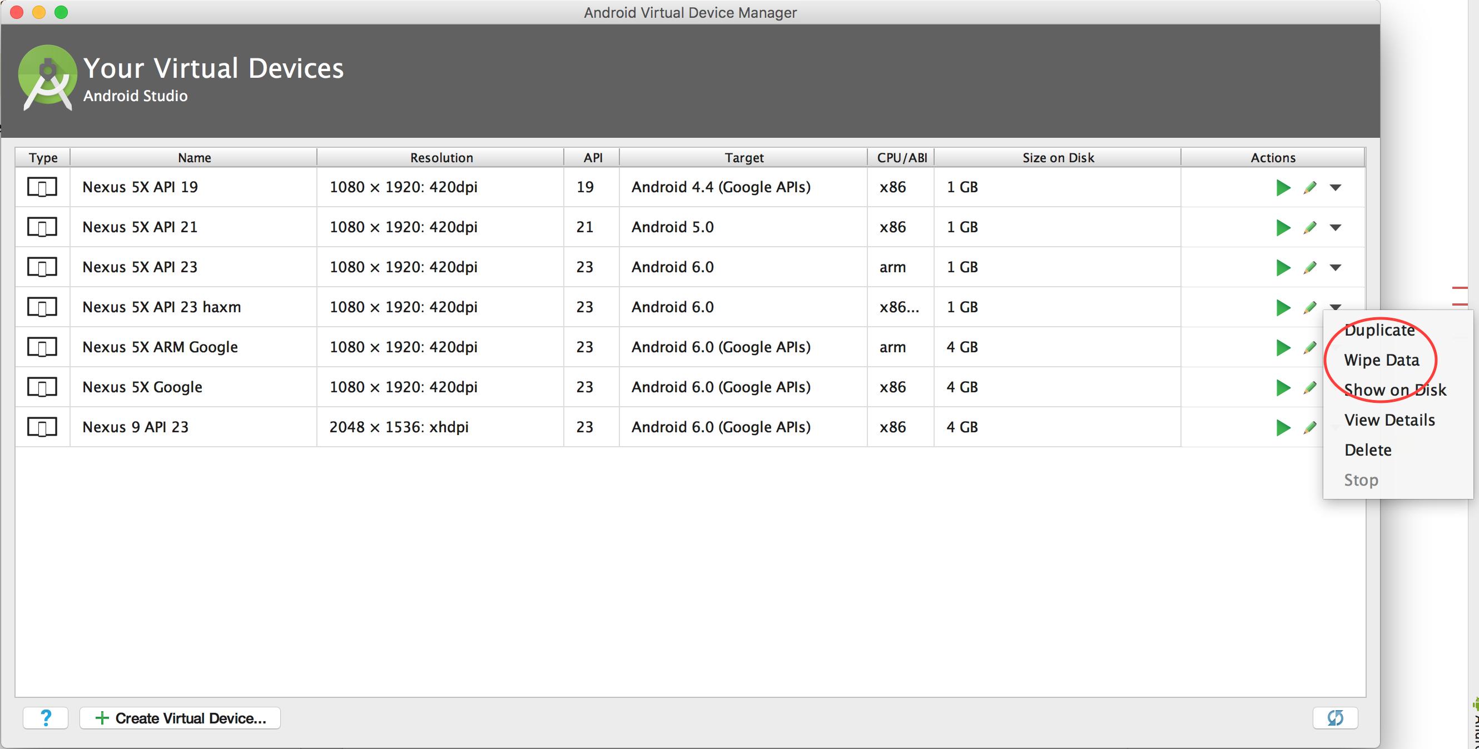

Slide 48
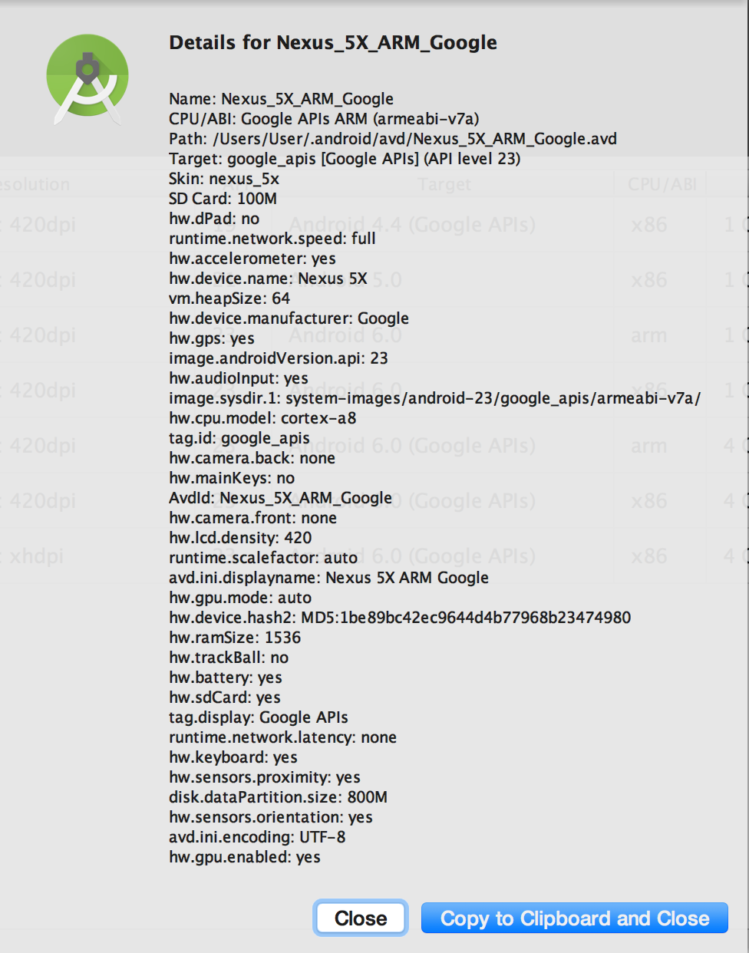
Notes:
Lives in .android/avd/Nexus_5X_API_23_haxm.avd/config.ini (editable)

Slide 49
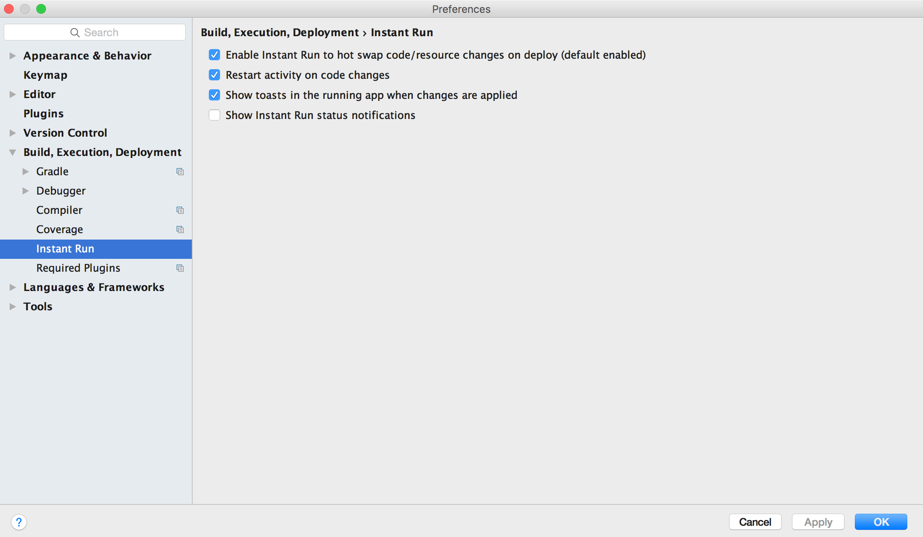
Notes:
Changes appear much quicker in the emulator
Android Studio 2.0 and above

Slide 50
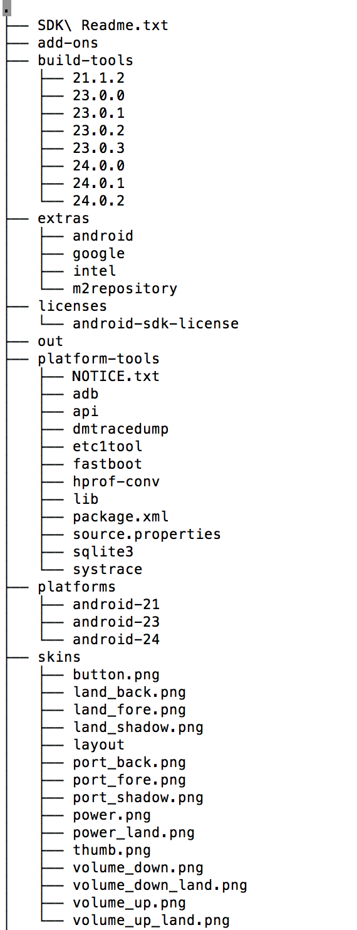
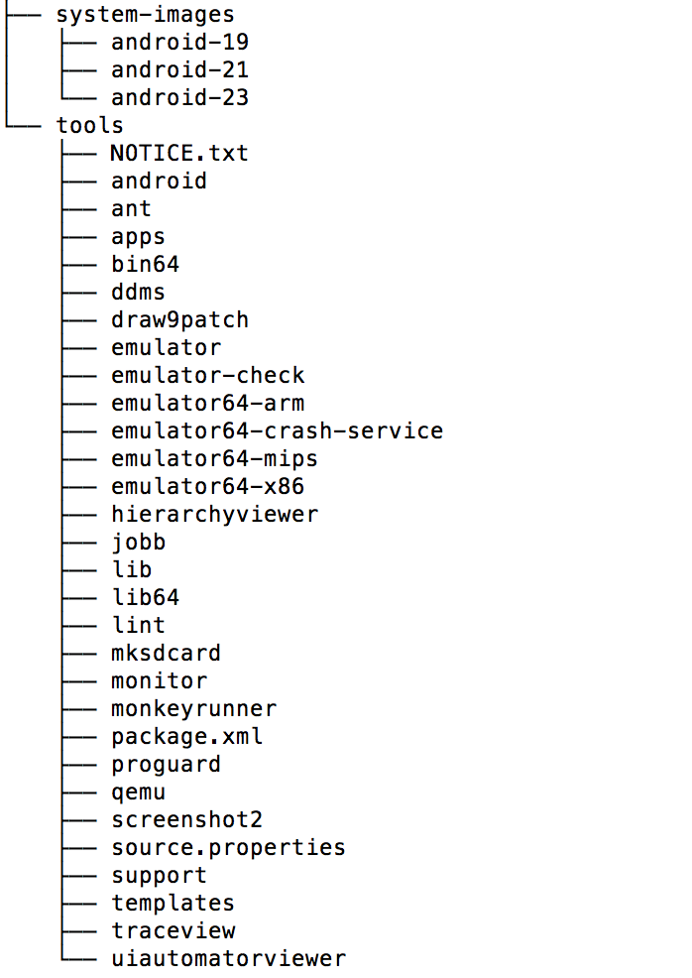
Notes:
Let’s take a look at the tools in the SDK

Slide 51
Virtual Device Tools
Android Virtual Device Manager
Android Emulator
mksdcard
Notes:
Virtual Device Tools
Android Virtual Device ManagerThe AVD Manager provides a graphical user interface in which you can create and manage Android Virtual Devices (AVDs) that run in the Android Emulator.
Android Emulator (emulator)A QEMU-based device-emulation tool that you can use to debug and test your applications in an actual Android run-time environment.
mksdcardHelps you create a disk image that you can use with the emulator, to simulate the presence of an external storage card (such as an SD card).

Slide 52
Development Tools
Hierarchy Viewer
SDK Manager
sqlite3
Notes:
Development Tools
Hierarchy Viewer (hierarchyviewer)Provides a visual representation of the layout's View hierarchy with performance information for each node in the layout, and a magnified view of the display to closely examine the pixels in your layout.SDK ManagerLets you manage SDK packages, such as installed platforms and system images.sqlite3Lets you access the SQLite data files created and used by Android applications.

Slide 53
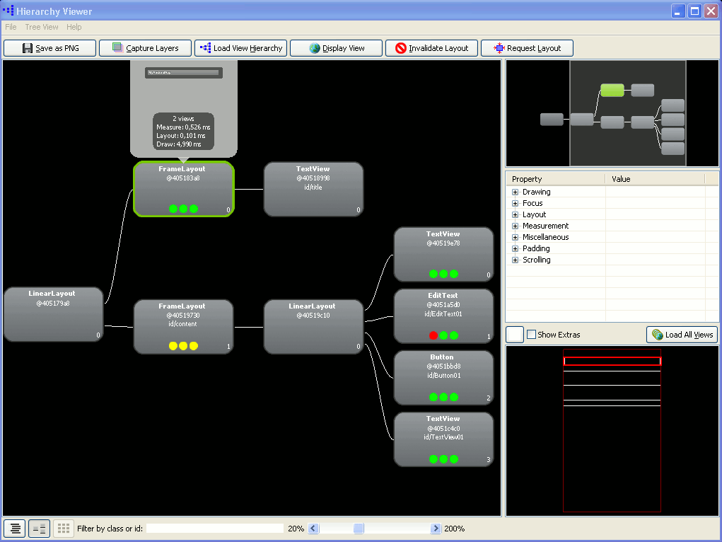

Slide 54
Debugging Tools
Android Monitor
adb
ADB Shell commands
Dalvik Debug Monitor Server (ddms)
Device Monitor
Systrace
traceview
Tracer for OpenGL ES
Notes:
Debugging Tools
Android MonitorAndroid Monitor is integrated into Android Studio and provides logcat, memory, CPU, GPU, and network monitors for app debugging and analysis.
adbAndroid Debug Bridge (adb) is a versatile command line tool that lets you communicate with an emulator instance or connected Android-powered device. It also provides access to the device shell.
ADB Shell CommandsLearn the commands available for advanced command-line operations.
Dalvik Debug Monitor Server (ddms)Lets you debug Android apps.
Device MonitorAndroid Device Monitor is a stand-alone tool that provides a graphical user interface for several Android application debugging and analysis tools.
SystraceLets you analyze the execution of your application in the context of system processes, to help diagnose display and performance issues.
traceviewProvides a graphical viewer for execution logs saved by your application.
Tracer for OpenGL ESAllows you to capture
OpenGL ES commands and frame-by-frame images to help you understand how your app is executing graphics commands.

Slide 55
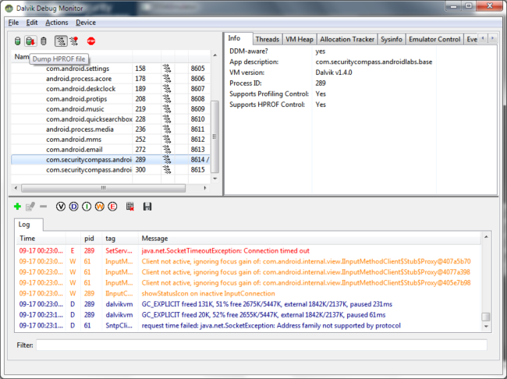

Slide 56
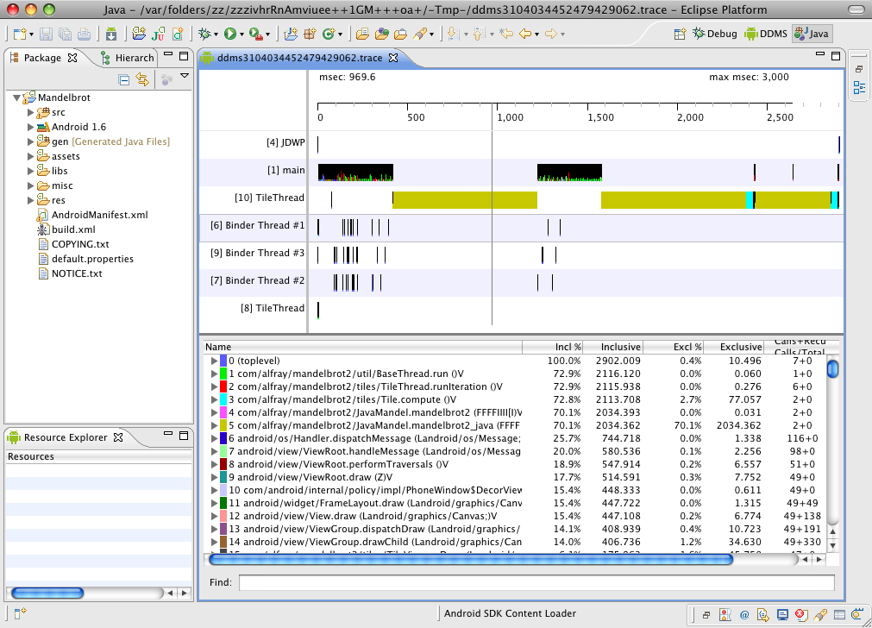

Slide 57
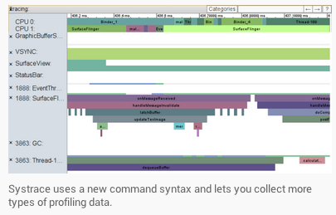

Slide 58
Build Tools
apksigner
JOBB
ProGuard
zipalign
Notes:
Build Tools
apksignerSigns APKs and checks whether APK signatures will be verified successfully on all platform versions that a given APK supports.
JOBBAllows you to build encrypted and unencrypted
APK expansion files in Opaque Binary Blob (OBB) format.
ProGuardShrinks, optimizes, and obfuscates your code by removing unused code and renaming classes, fields, and methods with semantically obscure names.
zipalignOptimizes APK files by ensuring that all uncompressed data starts with a particular alignment relative to the start of the file

Slide 59
Image Tools
Draw 9-patch
etc1tool
Notes:
Image Tools
Draw 9-patchAllows you to easily create a NinePatch graphic using a WYSIWYG editor. It also previews stretched versions of the image, and highlights the area in which content is allowed.
etc1toolA command line utility that lets you encode PNG images to the ETC1 compression standard and decode ETC1 compressed images back to PNG.

Slide 60
Thursday
Under the hood

